Slide 1

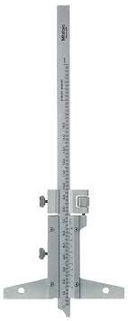
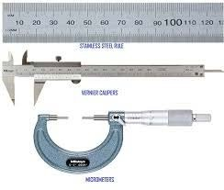
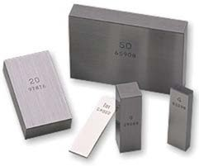
Linear Measurement
MICROMETER

Slide 2
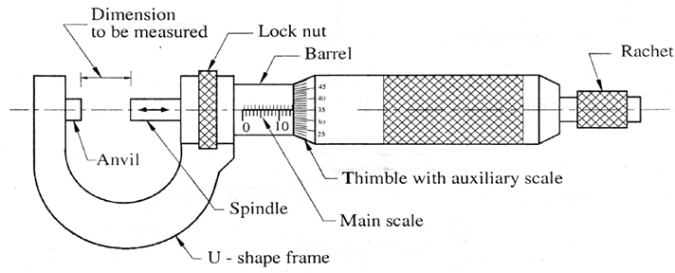
Micrometers
Useful device for magnifying small measurement
Accurate screw and nut are used for measurement
Micrometers works on the principle of screw and nut. The screw is attached to a concentric cylinder or thimble the circumference of which is divided into a number of equal parts. A screw is turned through nut by one revolution, its axial movement is equal to pitch of the thread of screw.
Construction

Slide 3
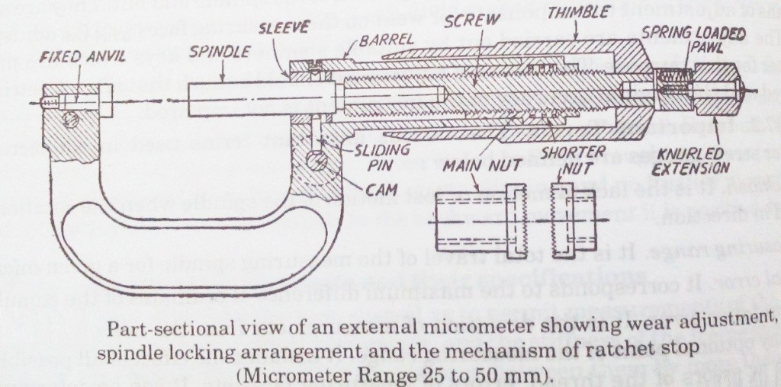

Slide 4


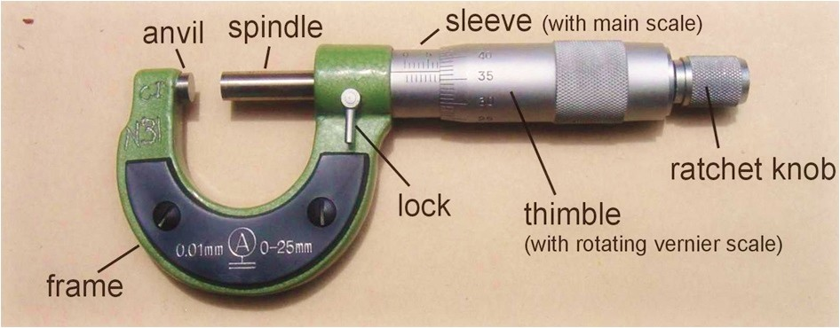
Micrometers

Slide 5
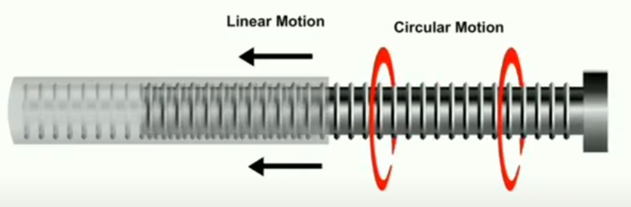
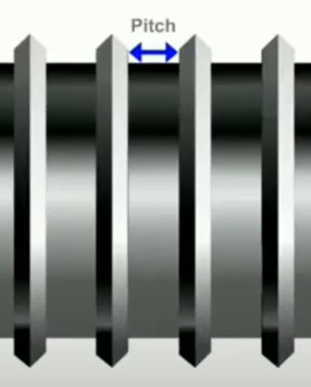

Principle of micrometer
$$Pitch =\frac{Distance moved by the screw}{No. of rotations of the screw}$$

Slide 6
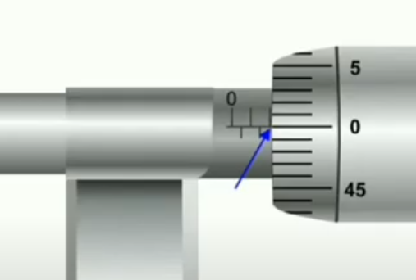
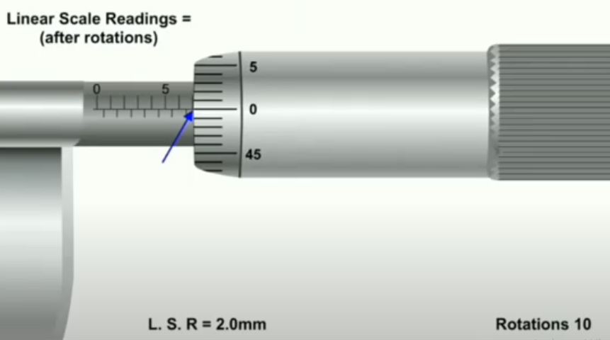
Steps to calculate pitch of micrometer
1. Let us set Micrometer at a linear scale reading of 2 mm.
2. Rotate the thimble for 10 rotations.
3. Note down the reading on main scale after rotations (its 7 mm)

Slide 7



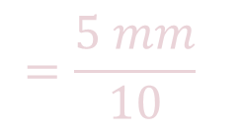
$$Pitch =\frac{Distance moved by the screw}{No. of rotations of the screw}$$
$$Pitch =\frac{7.00 mm −2.00 mm}{10}$$
$$=\frac{5 mm}{10}$$
$$Pitch =0.5 mm$$

Slide 8
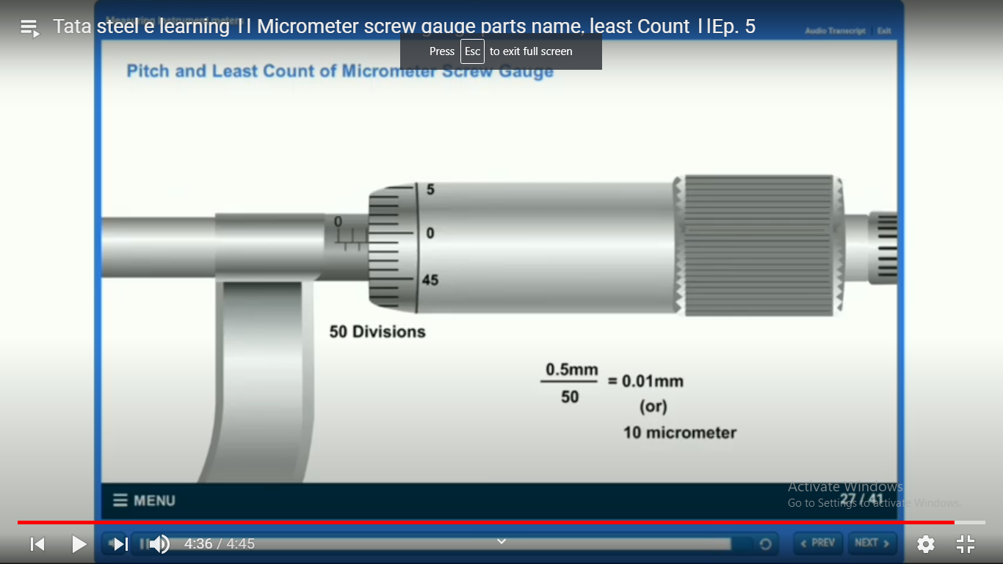

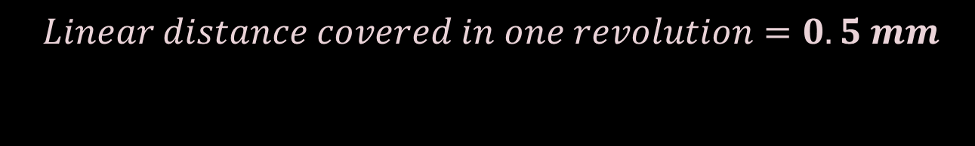
To calculate least count
As, $Pitch =0.5 mm$
We can say that ,
$$Linear distance covered in one revolution=0.5 mm$$

Slide 9
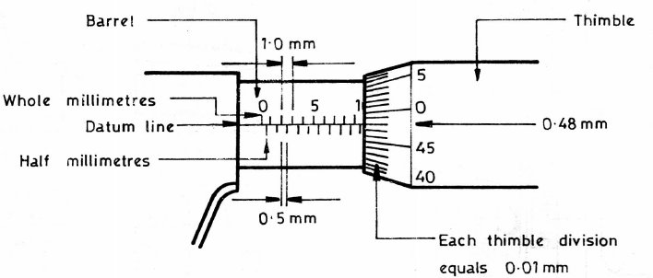
So, we can conclude below

Slide 10
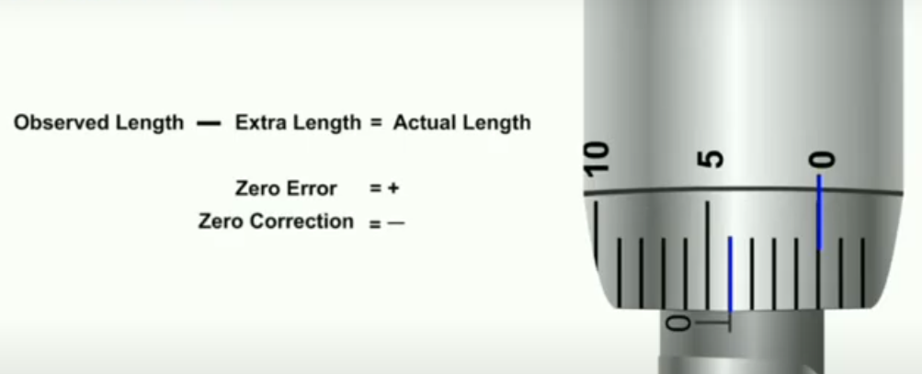
Zero error determination: +ve Zero error

Slide 11
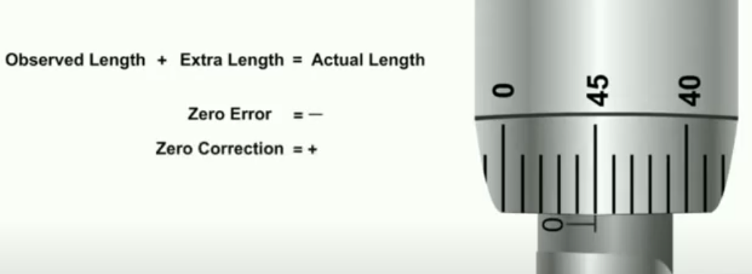
Zero error determination: -ve Zero error

Slide 12
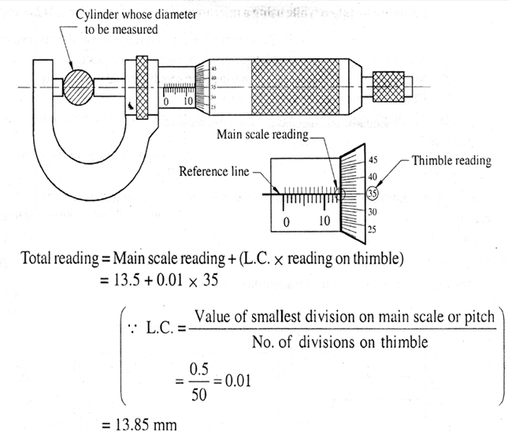
Lets check , what we learnt

Slide 13
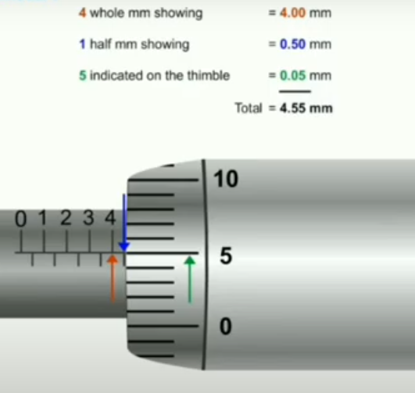

Slide 14

Types of micrometers
Outside micrometer
Inside micrometer
Vernier micrometer
Depth micrometer
Bench micrometer
Digital micrometer
Differential screw micrometer
Micrometer with dial gauge
Screw thread micrometer

Slide 15
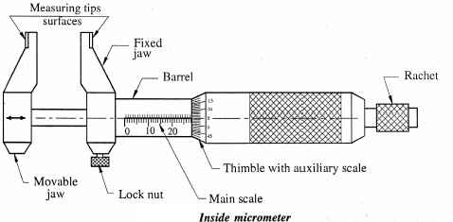
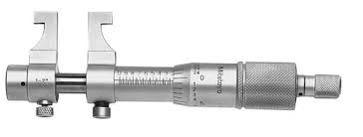
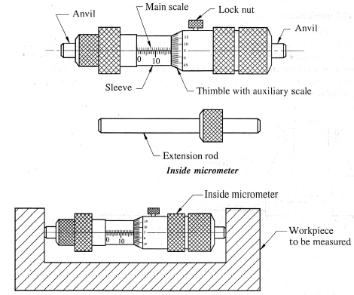
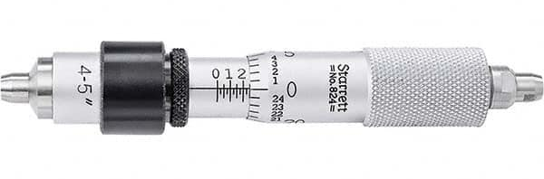
Inside Micrometer

Slide 16
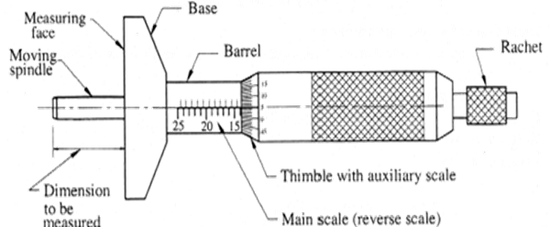
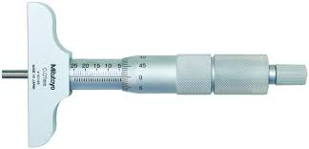
Depth Micrometer

Slide 17
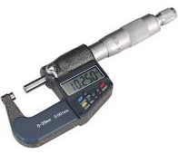
ANY QUESTIONS ????

