Slide 1

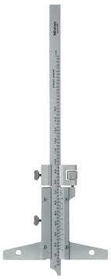
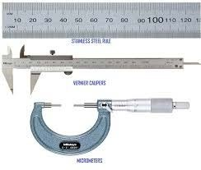
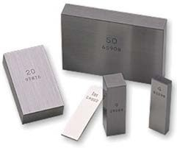
CHAPTER
Linear Measurement
Presentation Prepared by Prof. Naman M. Dave
Assistant Prof. (Mechanical Dept.) Gandhinagar Institute of Technology

Slide 2
Please refer this file just as reference material. More concentration should on class room work and text book methodology.

Slide 3
Linear Measurement
Measurement of perpendicular distance Between two points or surfaces. Designed either for line measurements or end measurements
Applies to measurement of length, heights, diameters, thicknesses, radius etc.
Line measuring instruments consists of series of accurately, spaced painted or marked lines on them

Slide 4
Linear Measuring instruments
(A)Classification based on methods of measurement
l. Direct measuring instruments.
2. Indirect measuring instruments.
Measuring instruments can be further classified as :
  Graduated instruments. It includes rules, vemier callipers, vernier height gauges, vernier depth gauges, micromètres, dial indicators etc.
  Non-graduated instruments : It includes callipers,, wire gauges, screw pitch gauges, radius gauges, thickness gauges, slip gauges etc.

Slide 5
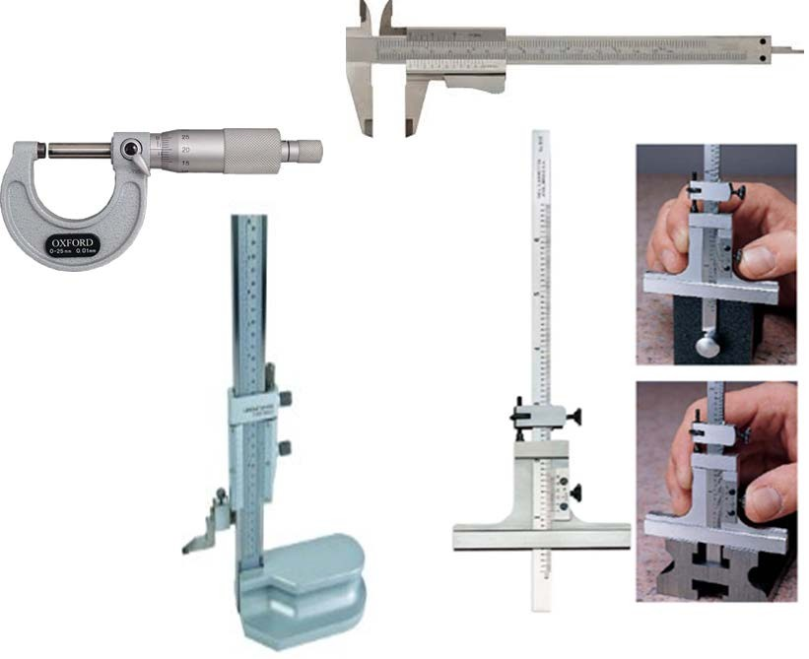

Graduated instruments

Slide 6
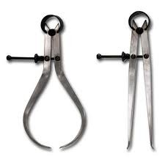
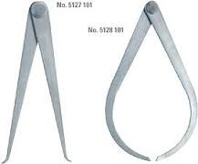
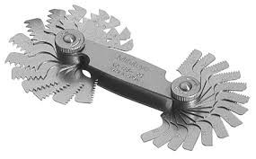
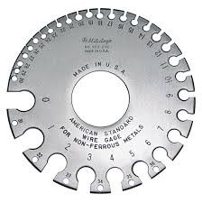
Non-graduated instruments
Callipers
Wire gauges
Screw pitch gauges
Notes:
Presenter
2016-02-12 14:19:36
--------------------------------------------
mp1

Slide 7
Linear Measuring instruments
(B) Classification based on the accuracy that can be obtained
l. Non-precision type instruments : It includes steel rule, caliper, divider; depth gauge, telescopic gauge etc.
2. Precision type instruments :It includes vernier calliper, vernier height gauge, vernier depth gauge, micrometer, slip gauges, etc.

Slide 8
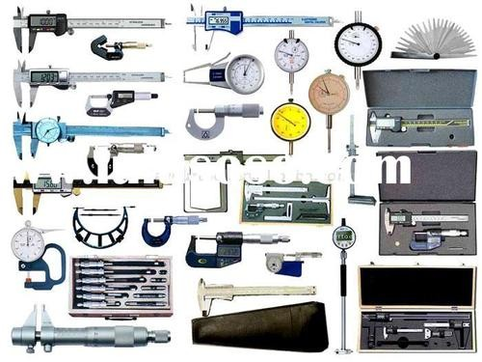

Slide 9
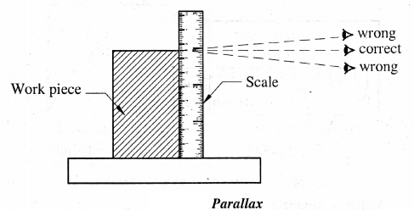
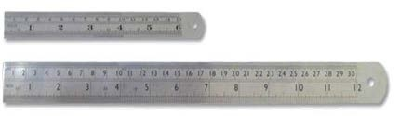
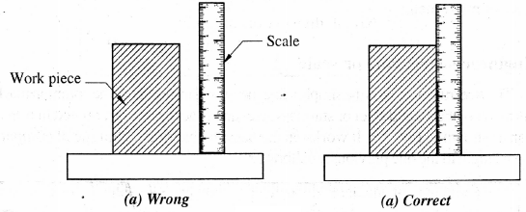
Steel Rule

Slide 10
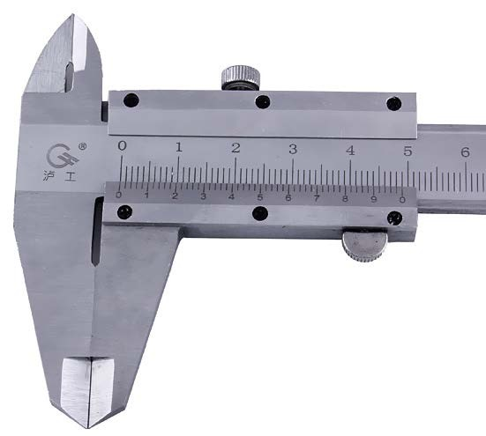

Least Count
Capability of an instrument to measure minimum distance accurately.
It represent the accuracy of measurement
Difference between the value of main scale division and auxiliary scale division.
Least count of vernier instruments
 L.C. of vernier instruments also can be calculated as

Slide 11
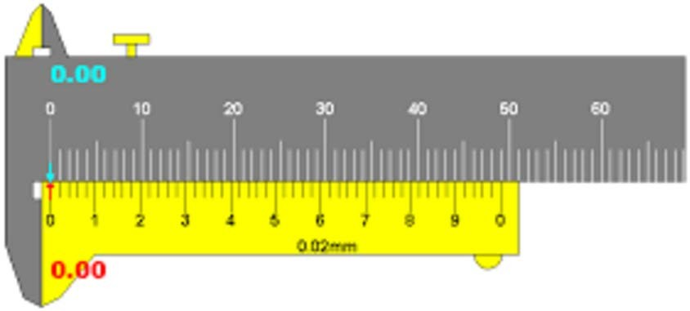
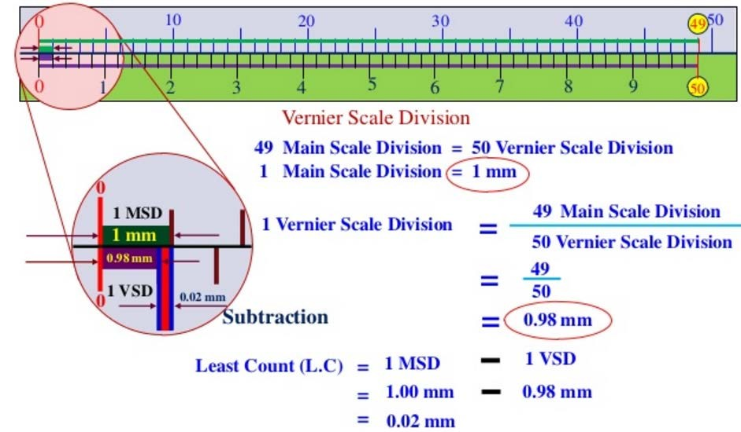
Least Count

Slide 12
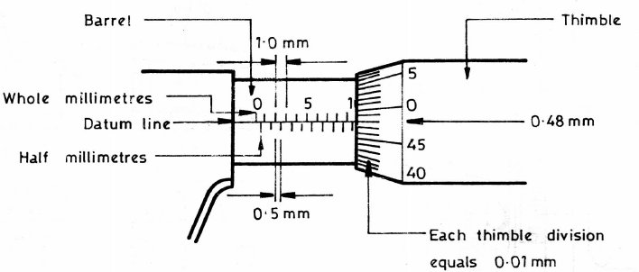
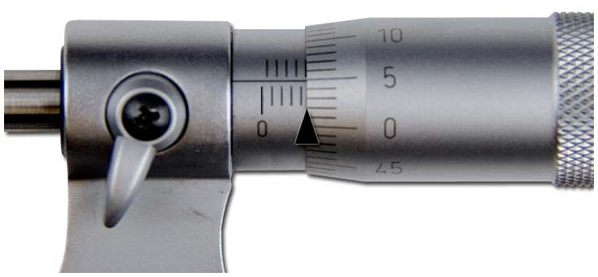


Least Count
Least count of micrometer

Slide 13
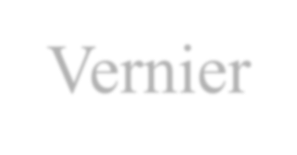
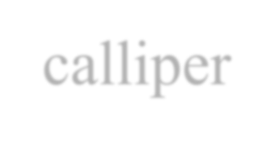
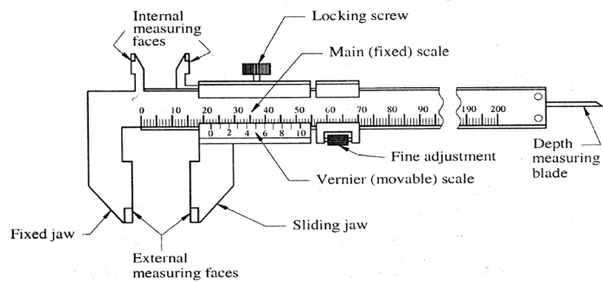
Vernier calliper
Vernier principle : When two scales (main and auxiliary scales) or division slightly different in size are used, the difference between them can be utilized to enhance the accuracy of measurement.
Construction :

Slide 14
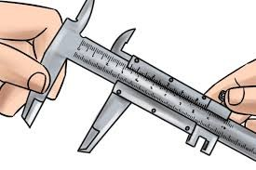
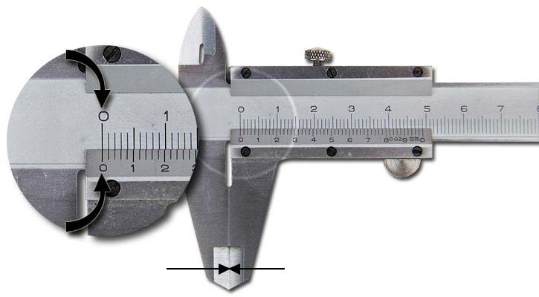
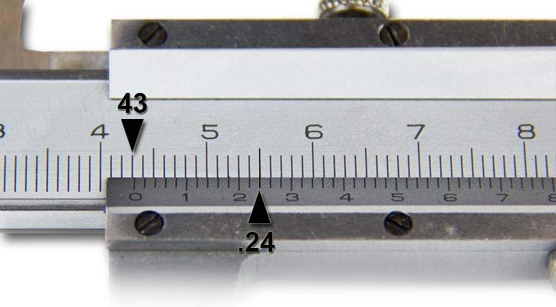
Working
Vernier calliper

Slide 15
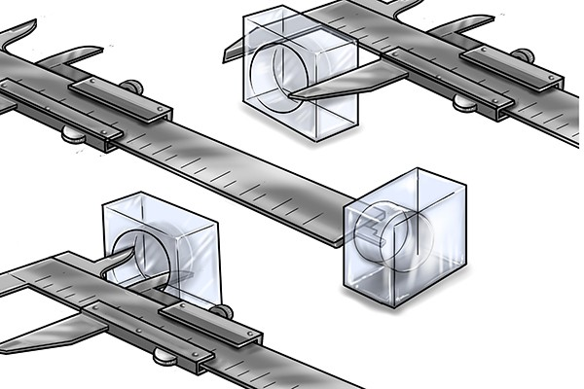

Slide 16
Errors in vernier calliper :
Errors due to play between the sliding jaw and fixed scale bar.
Error due to wear and wrapping of jaws.
Errors due to incorrect observation of scale readings
Errors due to excessive force on moving jaw.
Error is also introduced if the line of measurement does not coincide with the line of the scale

Slide 17
Precautions to be taken in use of vernier calliper :
No play should be there between sliding and fixed jaws. If play exists then the accuracy of the vernier calliper will be lost.
The tips of measuring jaws should not be worn . (3)Use the stationary jaw on reference point and obtain
measured point by sliding the movable jaws.
The vernier calliper must always be properly balanced in hand and held lightly the sliding jaw through adjusting screw. Do not push the moving jaw, under pressure, use adjusting screw for fine adjustment.
In case of measuring an outside diameter, be sure that calliper bar and the plane of Calliper jaws are truly perpendicular to the work piece's longitudinal centre line.

Slide 18
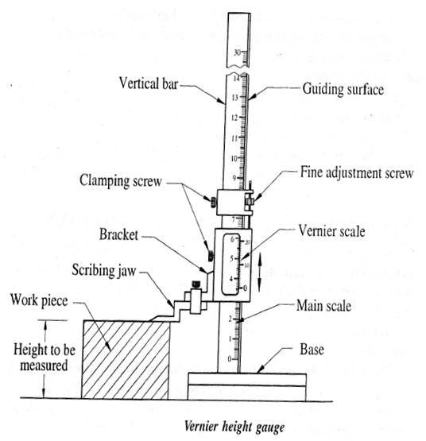
Vernier height guage
Similar to a vernier calliper except that the fixed jaw in this case is replaced by a fixed base which rests on a surface plate or table when taking measurements.
Precautions to be taken in use of vernier height gauge
It should be tested for straightness, squareness, and parallelism of working beam, measuring jaw and scriber.
base is clean and free from burrs.

Slide 19
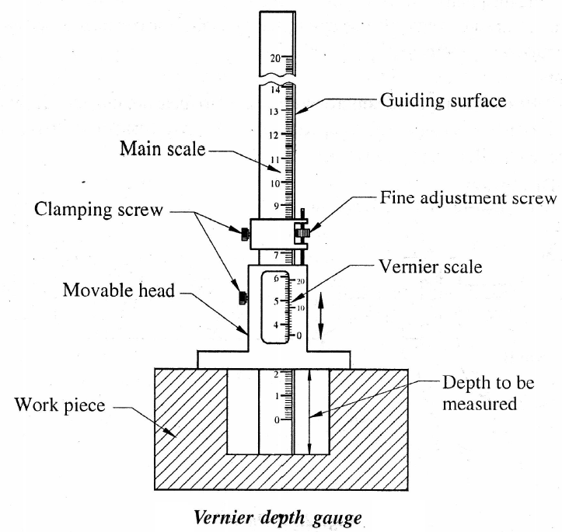
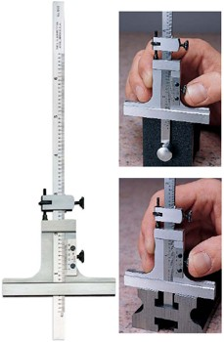
Vernier depth gauge

Slide 20

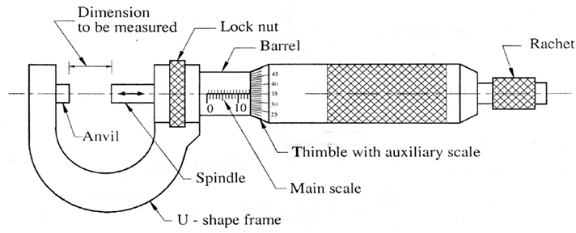
Micrometers
Useful device for magnifying small measurement
Accurate screw and nut are used for measurement
Micrometers works on the principle of screw and nut. The screw is attached to a concentric cylinder or thimble the circumference of which is divided into a number of equal parts. A screw is turned through nut by one revolution, its axial movement is equal to pitch of the thread of screw.
Construction

Slide 21
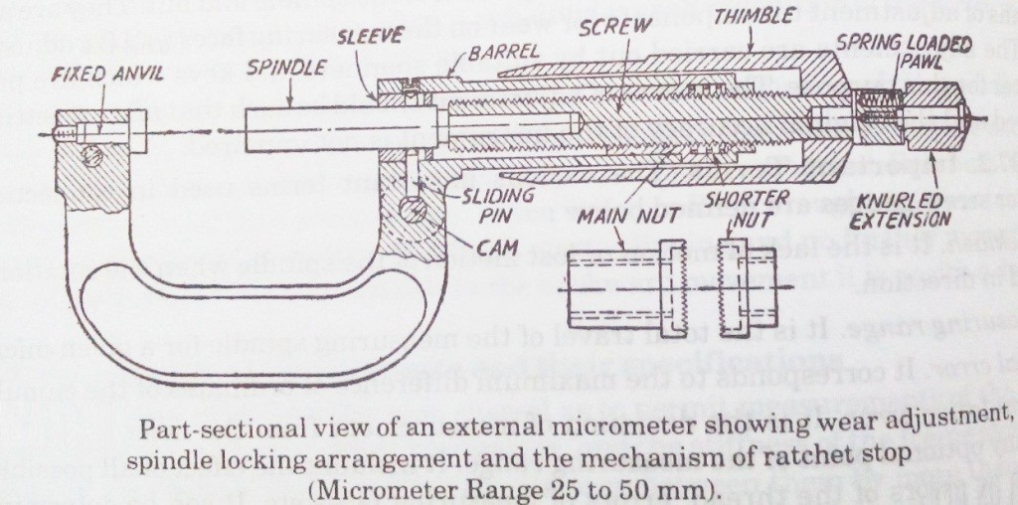

Slide 22

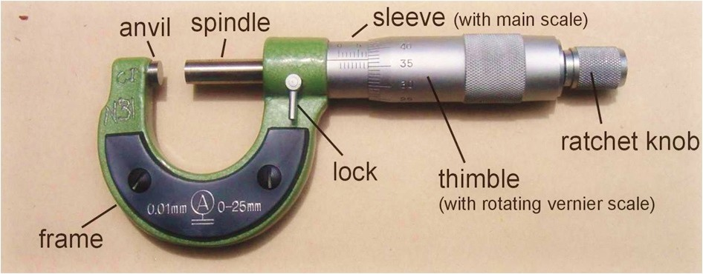
Micrometers

Slide 23

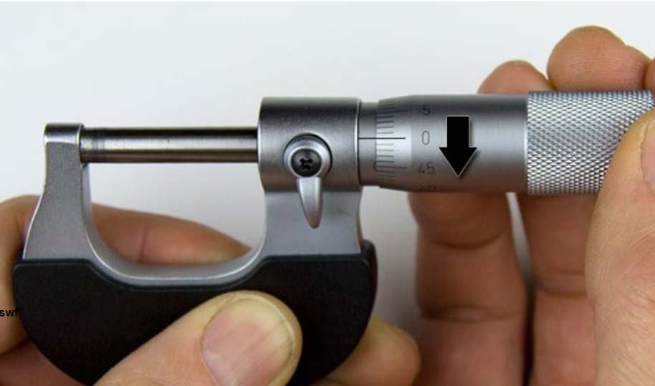
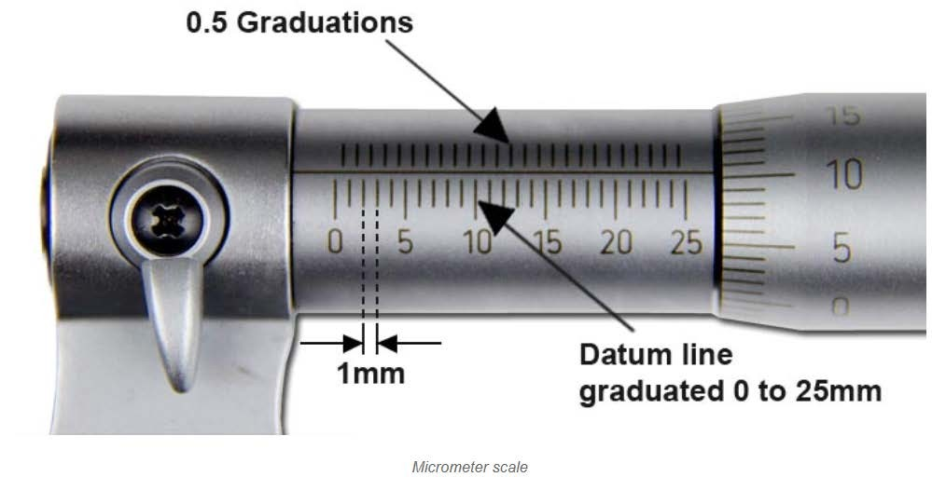

Slide 24
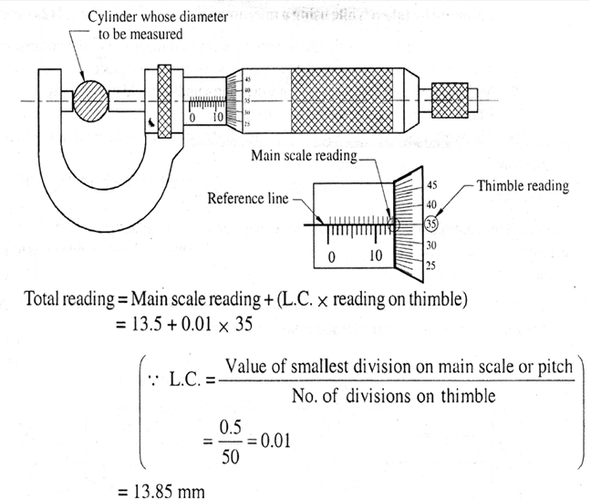
Micrometers
Working

Slide 25

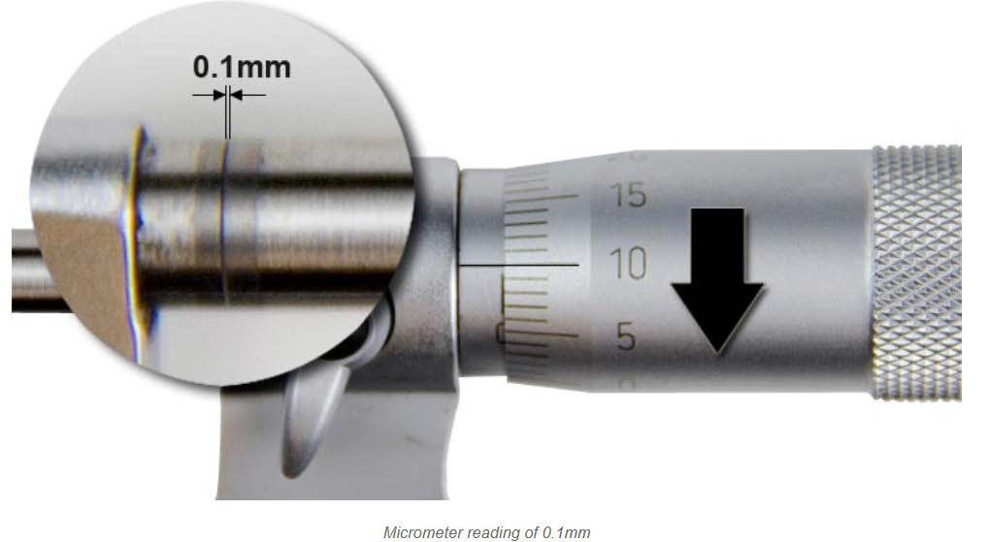

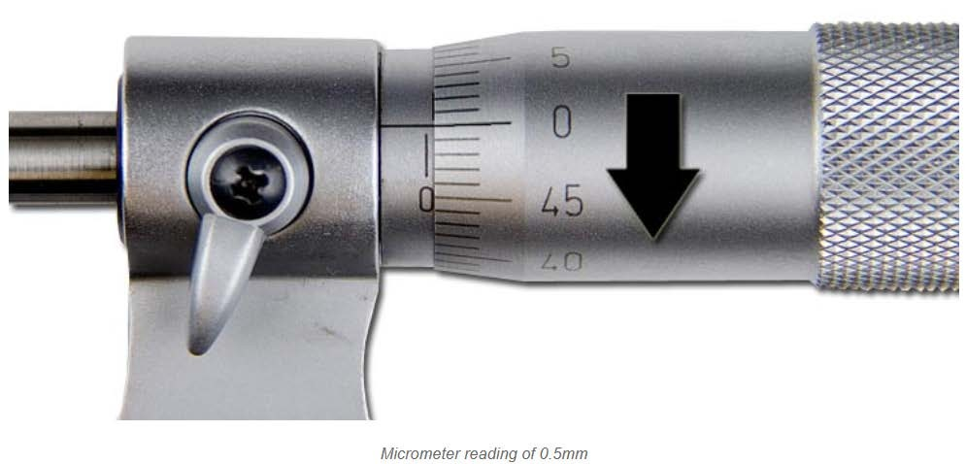

Slide 26
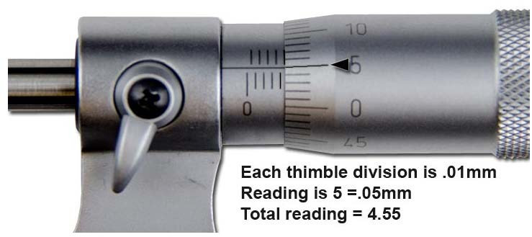

Slide 27
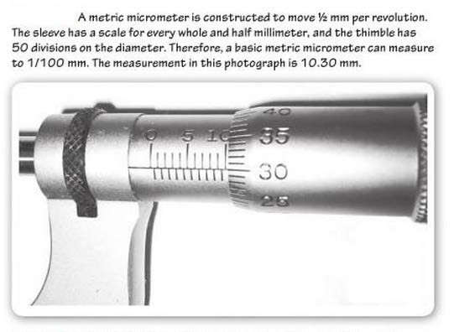

Slide 28

Types of micrometers
Outside micrometer
Inside micrometer
Vernier micrometer
Depth micrometer
Bench micrometer
Digital micrometer
Differential screw micrometer
Micrometer with dial gauge
Screw thread micrometer

Slide 29
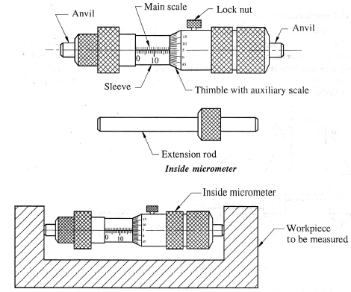
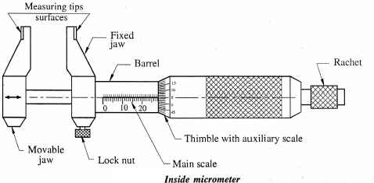
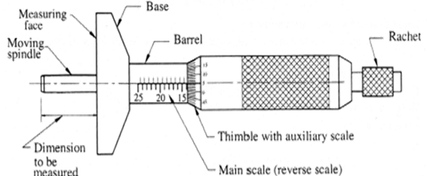
Inside Micrometer
Depth Micrometer

Slide 30
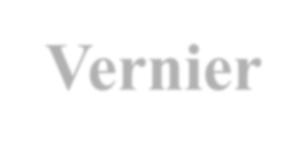

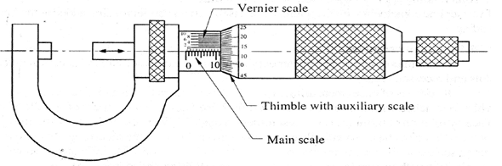
Vernier micrometers
In order to increase accuracy, the vernier principle also be applied to outside micrometer
Main scale is graduated on the barrel with two sets of division marks. The set below the reference line reads in mm and set above the line reads in 1/2 mm (0.5 mm).
Thimble scale is graduated on thimble with 50 equal divisions.
  Each small division of thimble represents 1/50 of minimum division of main scale.
  Main scale minimum division value is ½ mm (0.5mm). Hence each
division of thimble is equal to
0.5
50
= 0.01 mm
Notes:
Presenter
2016-02-12 14:19:53
--------------------------------------------
The micrometer screw has a pitch of 0.5 mm, while the thimble has a scale of 50 divisions round its circumference.
Thus, on making or rotating through one complete turn, the scale moves forward or backward by one thread pitch of 0.5 mm, and one division of its scale is, therefore, equivalent to a longitudinal movement of 0.5 × 1/50 mm = 0.01 mm. It is the value of one division on the thimble, which is the least that can be correctly read with the help of
a micrometer and is known as the least count.

Slide 31
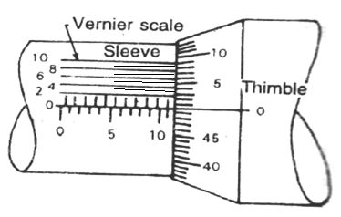

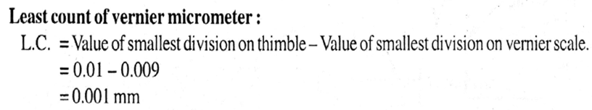
Vernier micrometers
Vemier scale is marked on barrel. There are “l0 divisions on barrel and this is equivalent to 9 divisions on the thimble.”
Hence division on vernier scale is equal to 9/10 that of thimble.
But one division on thimble is equal to 0.01 mm. Therefore, one division on vernier scale is equal ,to

Slide 32
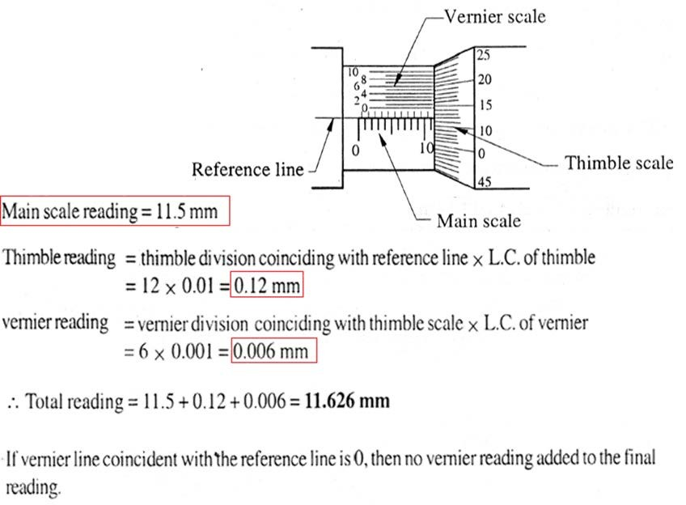
Vernier micrometers

Slide 33

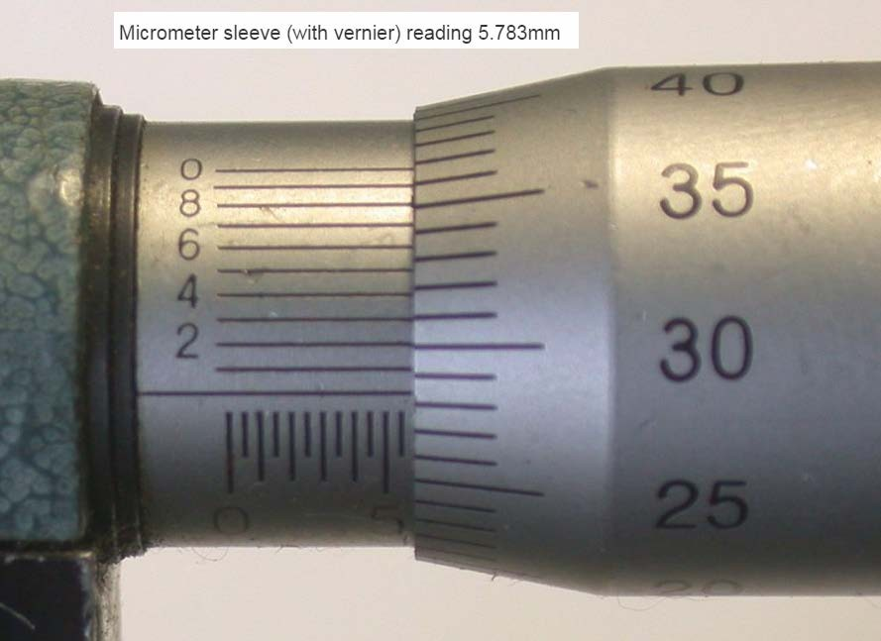

Slide 34

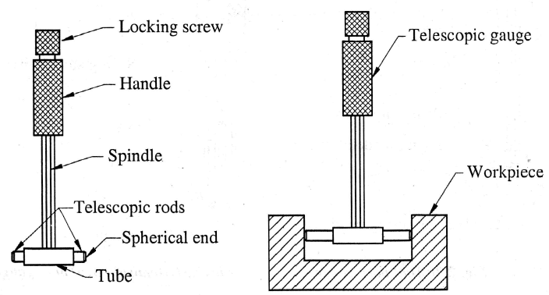
Telescopic gauge
Indirect measuring device
Used for measuring internal diameter of holes, slots and grooves etc
Consists of handle, two telescopic rods and locking screw

Slide 35
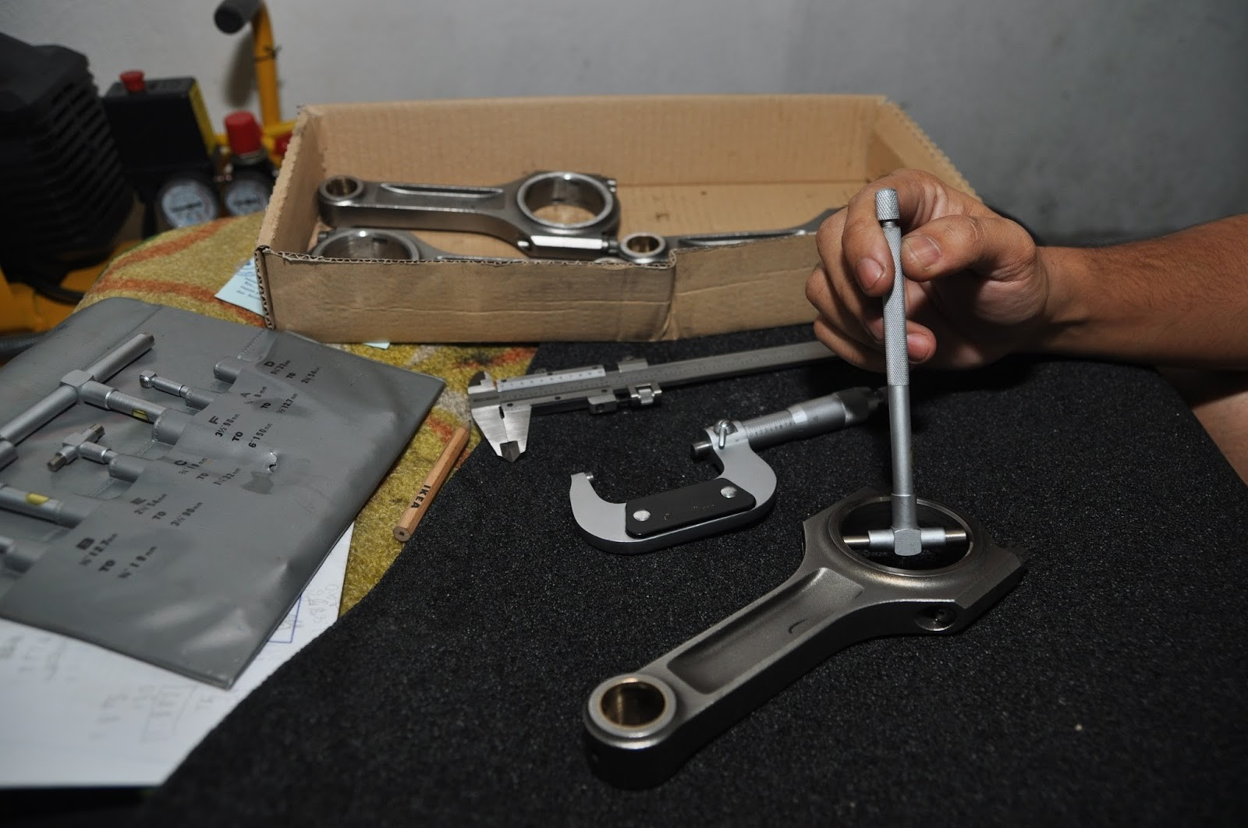

Slide 36
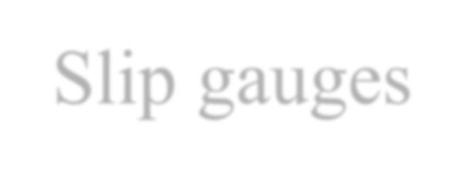
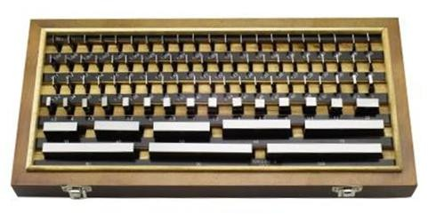

Slip gauges

Slide 37

Slip gauges
Universally accepted end standard of length in industry.
A rectangular block made up of high grade hardened steel.
Independent of any subsequent variation in size or shape
Carefully finished by high grade lapping to a high degree of finish, flatness and accuracy
  The opposite faces are of such a high degree of surface finish so that when the blocks are pressed together with a slight twist by hand, they will wring together. They will remain firmly attached to each other.

Slide 38

Slip gauges
Wringing occurs due to molecular adhesion between a liquid film (not more than 6 to 7 microns thick) and the mating surface.
This wringing process is used to build up desired dimensions over a range of sizes in specific increments.
The success of the wringing operation depends upon the surface finish and flatness of the blocks used and absence of dirt, grease, butts and scratches.
Notes:
Presenter
2016-02-12 14:20:01
--------------------------------------------
Wringing and Enforced Ad- hesion. The term ‘wringing’ refers to the conditions of intimate and complete contact and of permanent adhesion between measuring faces which is brought about by wringing together the surfaces in question without application of pressure, assuming that the surfaces have been thoroughly cleaned and exhibit a good standard of flat- ness and smoothness. The wrung gauge can be handled as a unit, without the need for clamping all the pieces together. It is believed that the phenomenon of wringing is due to molecular adhesion between a liquid film and the mating surfaces of the flat surfaces. In fact, the success of precision measurement by slip gauges depends on the phenomenon of wringing. It has been found that the gap between two wrung flat pieces is of the order of 0.00635 microns from which it would be very clear that the film thickness in two wrung flat pieces contributes no effect. It should be remembered that slip gauges are wrung together by hand through a combined blinding and twisting motion. First the gauge is oscillated slightly with very light pressure over other gauge so as to detect presence of any foreign particles between the sur- faces. One gauge is then placed perpendicular to other using standard gauging pressure and rotary motion is then applied until the blocks are lined up. In this way air is expelled from between the gauge faces causing the two blocks to adhere. This adherence is caused partly by molecular attraction and partly by atmospehric pressure (Refer Fig. 2.162). Similarly for separating two wrung slip gauges, combined sliding and twisting motion should be used and no at- tempt should be made to separate them by direct pull because considerable load would have to be applied which may damage the slip gauges. The overall thickness of the wrung gauges, for most practical purposes, is the sum of the individual sizes in combination. If during wringing, there is slightest feeling of roughness the process should be stopped and the surfaces examined for contamination. Wringing is thus defined as the property of measuring faces of a gauge block of adhering, by sliding or pressing the gauge against the measuring faces of other gauge blocks or the reference faces of datum surfaces, without the use of any extraneous means. The ‘enforced adhesion’ refers to the condition of contact over the entire surface and of permanent adhesion, which, owing to the lack of flatness or smoothness, can only be brought about by the application of pressure. It may be noted that the use of any extraneous agent to promote adhesion is not correct and it is sometimes specified that surfaces which are to be wrung together should be absolutely dry. On the other hand, a truly clean surface, though difficult to attain may not wring satisfactorily. The usual practice is to use silicone or filtered kerosene as lubricant, apply a thin coat of same and wipe it as thin as possible. There is as much danger from too little lubricant as from too much. http://what-when-how.com/metrology/slip-gauges-metrology/

Slide 39
Wringing

Slide 40

Slip gauges
Applications of slip gauges :
(l) They are used to check the accuracy of verniers, micrometers and other measuring devices.
They are used to set the comparator to a specific dimension.
They are used for direct precise measurement where the accuracy of work piece is important.
They are frequently used with sine bar to measure angle of work piece.
They can be used to check gap between parallel locations.

Slide 41

Limit gauges
Very widely used in industries.
As there are two permissible limits of the dimension of a part, high and low, two gauges are needed to check each dimension of the part, one corresponding the low limit of size and other to the high limit of size of that dimension. These are known as GO and NO-GO gauges.
GO gauges check the Maximum Metal Limit (MML) and NO-GO gauge checks the Minimum Metal Limit (LML).

Slide 42
Limit gauges
Taylor's Principle
  “On the ,Go, code of a limit gauge, all related dimensions should be checked simultaneously, while on the 'Not-Go' side each dimension is to be checked separately.”
  This means that the, “Go” gauge must have the ideal theoretical form of its mating part and it should be used under the condition of maximum impossibility.
  The "Not Go" gauge should ensure point contact with its mating part so that any geometrical inaccuracy that exists outside the limits of the dimensional tolerance can be detected. It must therefore, be used under the condition of maximum possibility.

Slide 43

Limit gauges
The "Go" side of the limit gauges should enter the hole (or cavity) or just pass over the shaft under the weight of the gauge without using any force.
The "Not Go" side of the gauge must not enter or pass.

Slide 44
Limit gauges
A part is considered to be good, if the GO gauge passes through or over the work and NO-GO gauge fails to pass under the action of its own weight. This indicates that the actual dimension of the part is within the specified tolerance.
If both the gauges fail to pass, it indicates that hole is under size or shaft is over size.
If both the gauges pass, it means that the hole is over size or the shaft is under size.

Slide 45

Types of Limit gauges
According to the form of the tested surface :
Plug gauges for checking holes.
Snap and ring gauges for checking shafts.
According to their design :
Single limit and double limit gauges,
Single ended and double ended gauges,
Fixed and adjustable gauges.

Slide 46
Types of Limit gauges
According to their purposes
Workshop limit gauges to be used on the machine for gauging the dimensions of the components during production.
Inspection limit gauges to be used in the inspection department for checking the component after production.
Reference limit gauges to be used in the metrology laboratory for reference proposes.

Slide 47


Limit gauges

Slide 48

Limit gauges

Slide 49

Limit gauges

Slide 50

Limit gauges

Slide 51


Limit gauges

Slide 52

Limit gauges

Slide 53
Linear Measurement
Classification
Gauges
Steel rule, Ordinary caliper, etc,…
Least Count
Vernier Calipers and Micrometers
Slip Gauges
Telescopic Gauges
Limit Gauges, etc…
Principle
Construction and Working
Reading of measured value
Types
Errors and precautions in both instruments

Slide 54


Chapter 2
Part 1
Linear Measurement
Part 2 Angular Measurement

