Slide 1
TECHNO INDIA NJR INSTITUTE OF TECHNOLOGY
ENGINEERING DRAWING
PRESENTATION BY: Narenda Singh
1

Slide 2

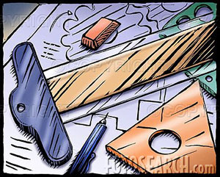
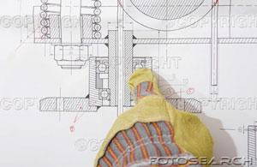
Engineering Drawing–I
Notes:
2

Slide 3
CLASSIFICATION OF DRAWING
DRAWING
ARTISTIC
DRAWING
ENGINEERING
DRAWING
3

Slide 4
DRAWING
Graphical representation of an object is called drawing.
Representing an object using lines, arcs, circles, etc which gives some meaning to the reader is called drawing.
Universal language of Engineers.
Graphic language of Engineers.
Mode of communication through sketches is called Graphic language.
4

Slide 5
Drawing Scales
Scale is the ratio of the linear dimension of an element
of an object shown in the drawing to the real linear
dimension of the same element of the object.
Size in drawing
Actual size
:
5
Notes:
5

Slide 6
Drawing Scales
Designation of a scale consists of the word “SCALE”
followed by the indication of its ratio, as follow
SCALE 1:1 for full size
SCALE X:1 for enlargement scales (X > 1)
SCALE 1:X for reduction scales (X > 1)
Dimension numbers shown in the drawing are correspond
to “true size” of the object and they are independent of
the scale used in creating that drawing.
6

Slide 7
Meaning of Lines
Visible lines represent features that can be seen in the
current view
Hidden lines represent features that can not be seen in
the current view
Center line represents symmetry, path of motion, centers
of circles, axis of axisymmetrical parts
Dimension and Extension lines indicate the sizes and
location of features on a drawing
7

Slide 8
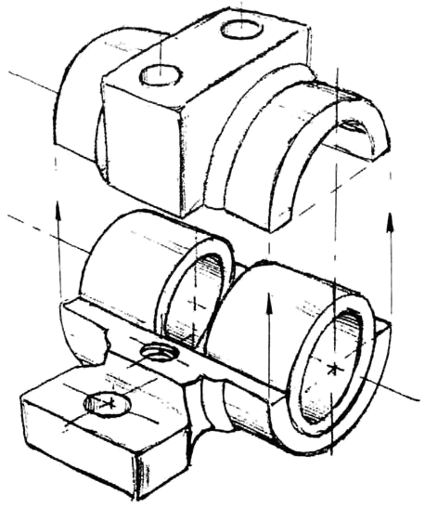
Dimensioning
8

Slide 9
Dimensioning Guidelines
The term “feature” refers to surfaces, faces, holes, slots, corners, bends, arcs and fillets that add up to form an engineering part.
Dimensions define the size of a feature or its location relative to other features or a frame of reference, called a datum.
The basic rules of dimensioning are:
  Dimension where the feature contour is shown;
  Place dimensions between the views;
  Dimension off the views;
  Dimension mating features for assembly;
  Do not dimension to hidden lines;
  Stagger dimensioning values;
  Create a logical arrangement of dimensions;
  Consider fabrication processes and capabilities;
  Consider inspection processes and capabilities.
9

Slide 10
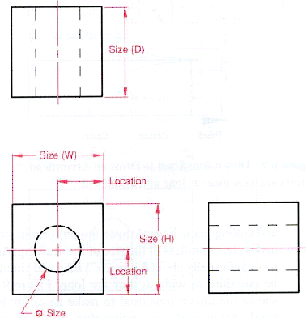
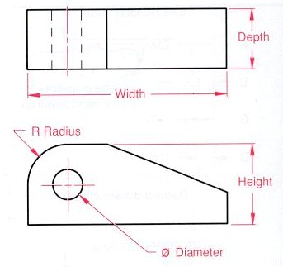
Important elements of dimensioning
Two types of dimensioning: (1) Size and location dimensions and (2) Detail dimensioning
10

Slide 11
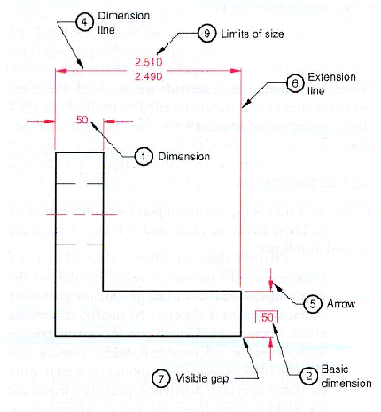
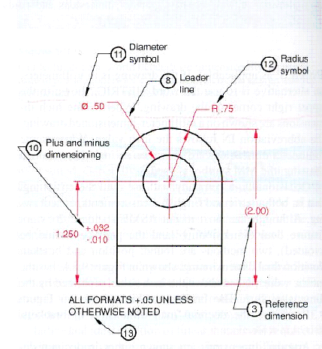
Elements of a dimensioned drawing (Be familiar with these terms
11

Slide 12
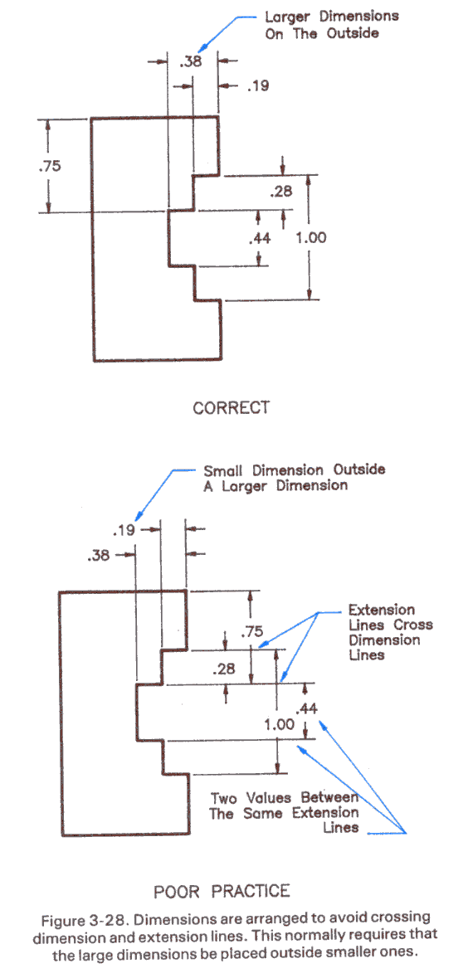
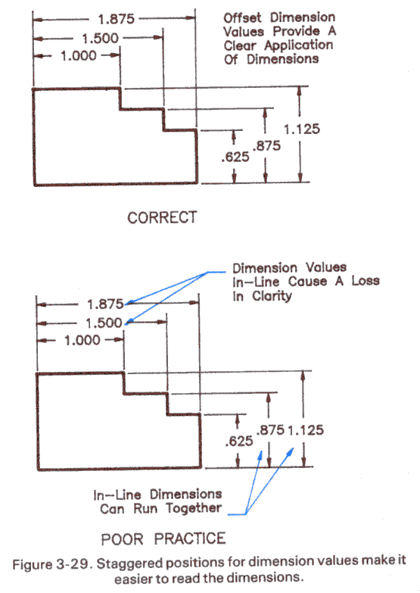
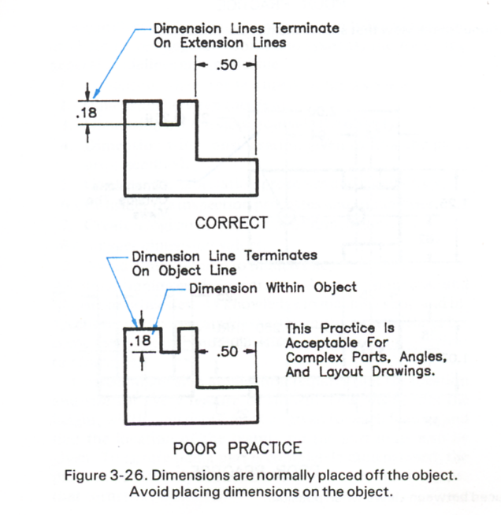
Arrangement of Dimensions
Keep dimension off of the part where possible.
Arrange extension lines so the larger dimensions are outside of the smaller dimensions.
Stagger the dimension value labels to ensure they are clearly defined.
12

Slide 13
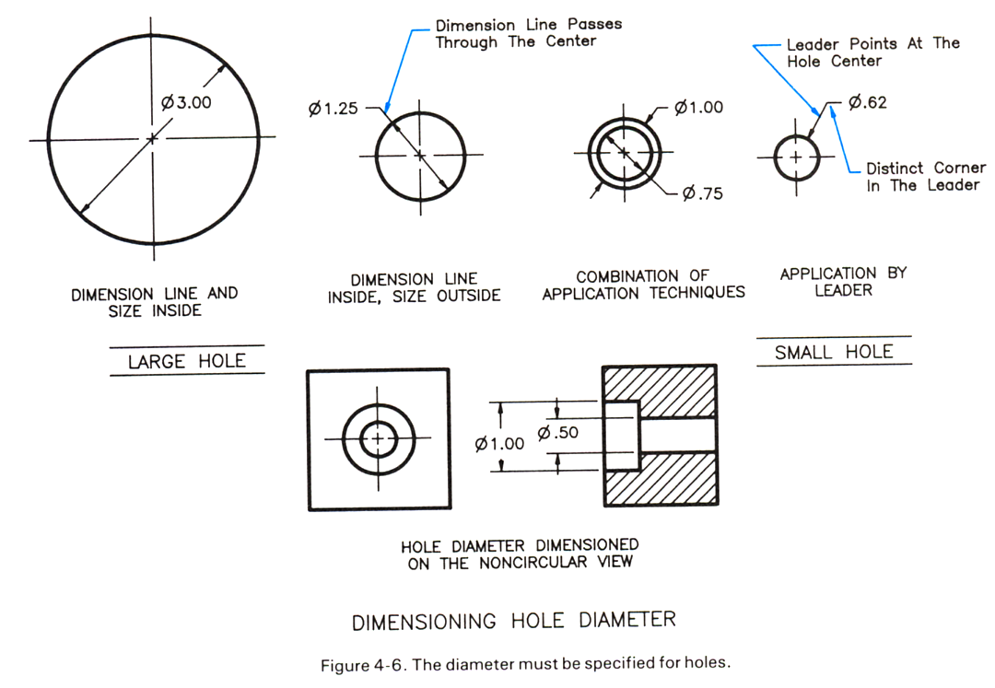
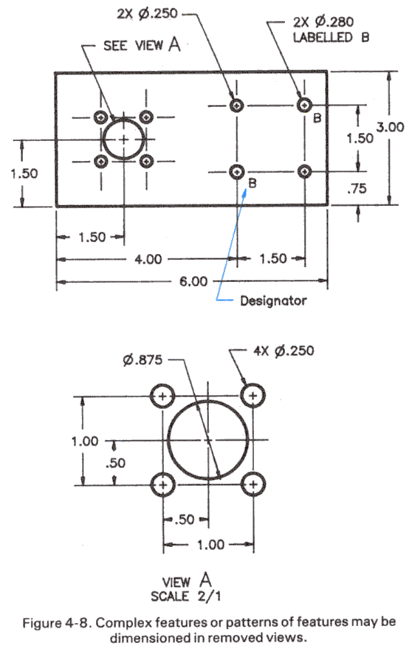
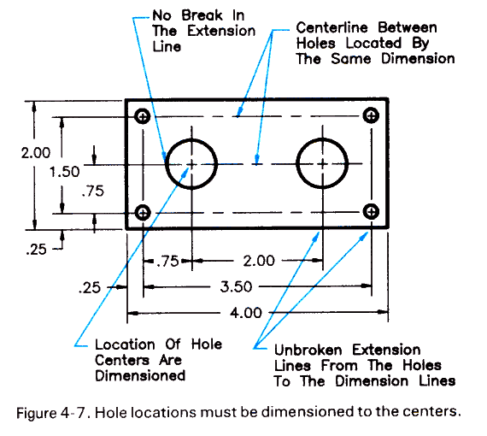
Dimensioning Holes
Dimension the diameter of a hole.
Locate the center-line.
Use a notes and designators for repeated hole sizes
13

Slide 14
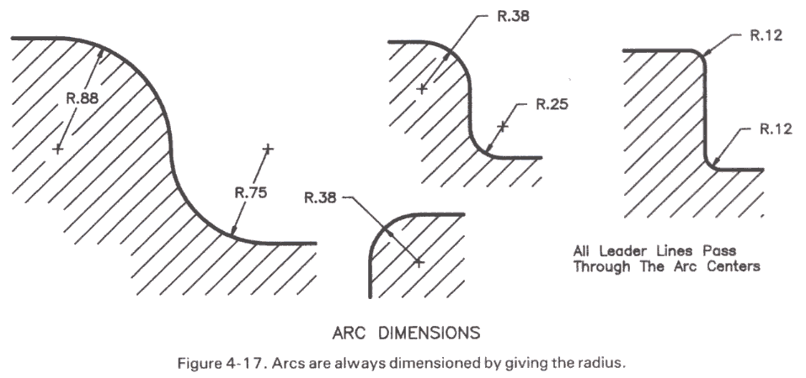
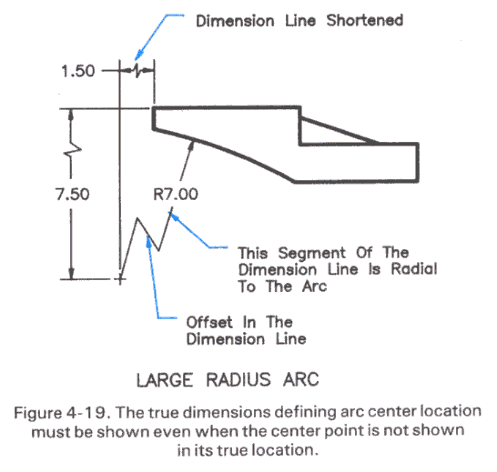
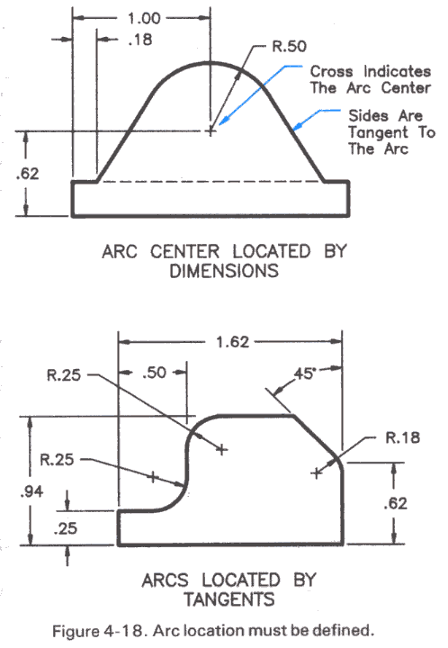
Dimensioning the Radius of an Arc
Dimension an arcs by its radius.
Locate the center of the radius or two tangents to the arc.
14

Slide 15
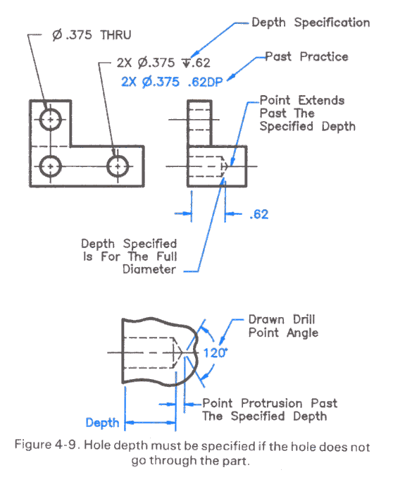
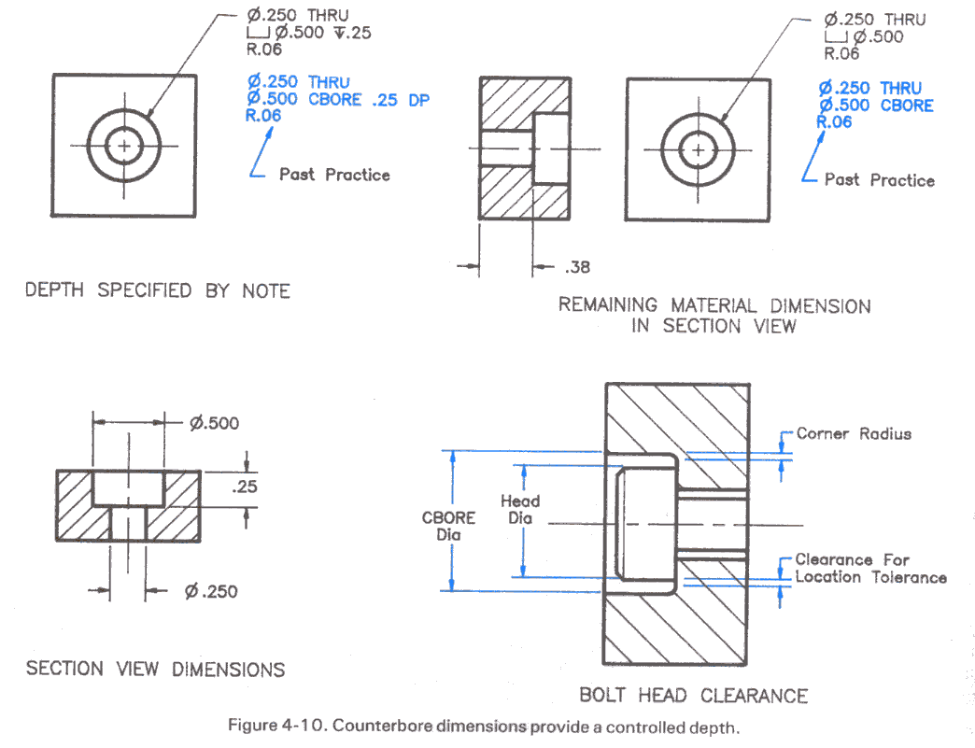
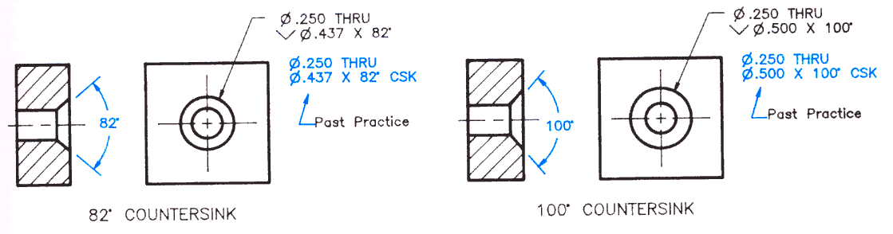
Drilled Holes, Counter bores and Countersinks
Use the depth symbol to define the depth of a drilled hole.
Use the depth symbol or a section view to dimension a counter bore.
Countersinks do not need a section view.
15

Slide 16
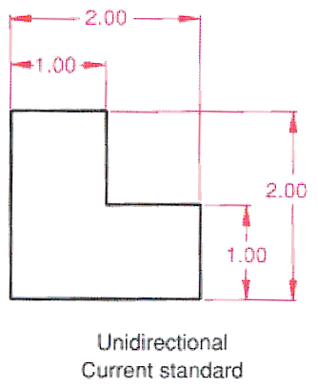
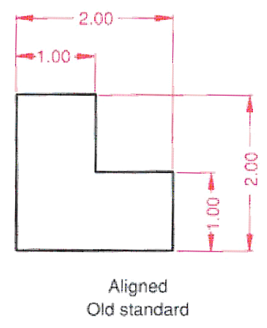
Unidirectional or aligned dimensioning?
16

Slide 17

Orthographic
Projection

Slide 18
GEOMETRICAL OBJECTS
Dimensionless objects
One dimensional objects
Two dimensional objects
Three dimensional objects
18

Slide 19
EXAMPLES
POINT IS A DIMENSIONLESS OBJECT
LINE IS A ONE DIMENSIONAL OBJECT
PLANE/ LAMINA IS A TWO DIMENSIONAL OBJECT
SOLID IS A THREE DIMENSIONAL OBJECT
19

Slide 20
PROJECTOR
FILM
RAY OF LIGHT
VIEW
LIGHT SOURCE
RAY OF LIGHT
LENS
OBJECT
PLANE OF PROJECTION
PRINCIPLE OF PROJECTION
SCREEN
20

Slide 21


PRINCIPLE OF PROJECTION
PLANE OF PROJECTION
RAYS OF SIGHT
MEAN POSITION
OBJECT
GROUND
21

Slide 22

ORTHOGRAPHIC PROJECTION
OBJECT
PROJECTORS
LIGHT RAYS
LIGHT RAYS
PLANE OF PROJECTION
SOURCE
∞
LIGHT RAYS
PROJECTORS
22

Slide 23
ORTHOGRAPHIC PROJECTION
Orthographic projection is a means of representing a three-dimensional (3D) object in two dimensions (2D). It uses multiple views of the object.
1. First angle projection
2. Second angle projection (overlapping)
3. Third angle projection
4. Fourth angle projection (overlapping)
23

Slide 24
Drawings convey the following critical information:
Geometry – the shape of the object; represented as views; how the object will look when it is viewed from various angles, such as front, top, side, etc.
Dimensions – the size of the object is captured in accepted units.
Tolerances – the allowable variations for each dimension.
Material – represents what the item is made of.
Finish – specifies the surface quality of the item, functional or cosmetic.
For example, a mass-marketed product usually requires a much higher surface quality than, say, a component that goes inside industrial machinery.
Information box or Title block containing who drew the drawing, who approved it, units of dimensions, meaning of views, the title of the drawing, revision number, drawing number etc.
And many more like Important notes.
24

Slide 25
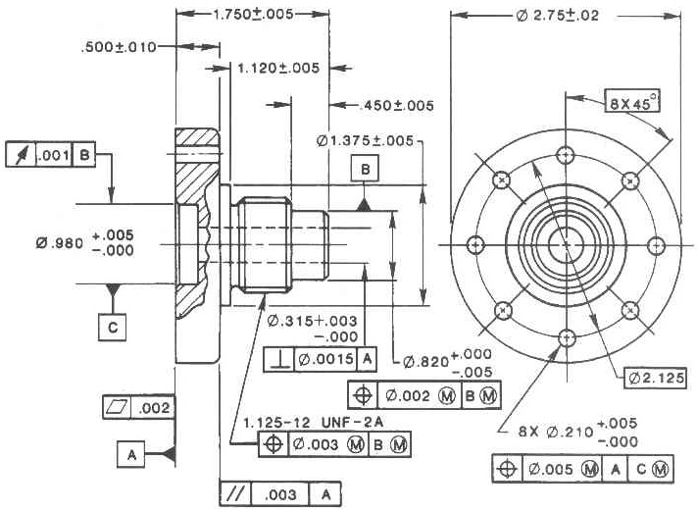
NEXT SEMINAR’S TOPIC
25

