Slide 1





5S
-Hiroyuki Hirano

Slide 2

What is 5S?
5S is a workplace organization methodology that uses a list of five Japanese words which
are seiri, seiton, seiso, seiketsu and shitsuke.

Slide 3


Translated into English, they stand for:
Sorting (seiri)
Straightening (seiton)
Systematic cleaning (seiso)
Standardizing (seiketsu)
Sustaining (shitsuke)

Slide 4



Sorting (Seiri)
Eliminate all unnecessary tools, parts, and instructions.
Keep only essential items and eliminate what is not required
Prioritizing things per requirements and keeping them in easily-accessible places.
Everything else is stored or discarded.

Slide 5
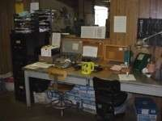
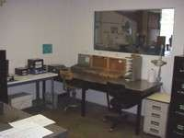

Slide 6


Straightening or setting in order / stabilize (Seiton)
There should be a place for everything and everything should be in its place.
The place for each item should be clearly labelled or demarcated.
Items should be arranged in a manner that promotes efficient work flow, with equipment used most often being the most easily accessible.

Slide 7
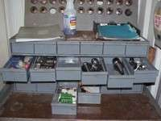
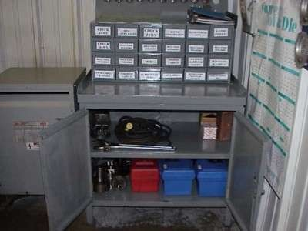

Slide 8






shining or systematic cleaning (Seiso)
Clean the workspace and all equipment, and keep it clean, tidy and organized.
At the end of each shift, clean the work area and be sure everything is restored to its place.
Maintaining cleanliness should be part of the daily work – not an occasional activity initiated when things get too messy.

Slide 9




Slide 10


Standardizing (Seiketsu)
All work stations for a particular job should be identical.
All employees doing the same job should be able to work in any station with the same tools that are in the same location in every station.
Everyone should know exactly what his or her responsibilities are for adhering to the first 3 S's.

Slide 11
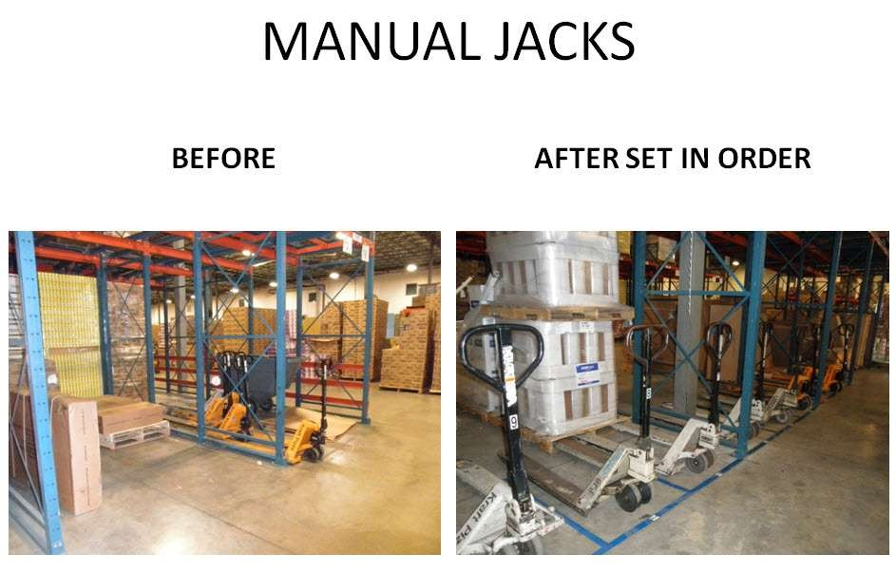

Slide 12




Sustaining the discipline or self-discipline (Shitsuke)
Maintain and review standards.
Maintain focus on this new way and do not allow a gradual decline back to the old ways.
While thinking about the new
way, also be thinking about yet better ways.

Slide 13
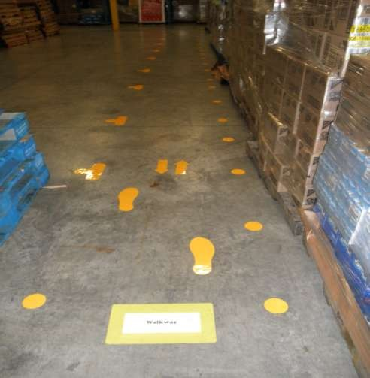

Slide 14

BENEFITS OF 5S
improves organizational efficiency
reduces waste in all forms
cuts down employee frustration when "the system doesn’t work"
improves speed and quality of work performance
improves safety
creates a visually attractive environment

Slide 15

OBJECTIVES OF 5S
Productivity
Safety
Reduced Waste
Worker Commitment

Slide 16
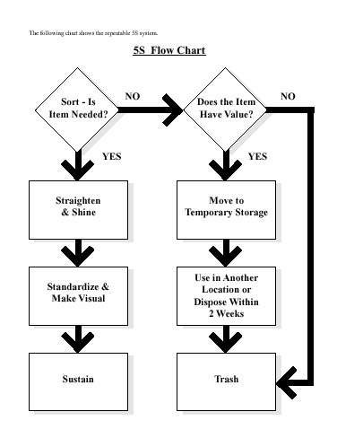

Slide 17
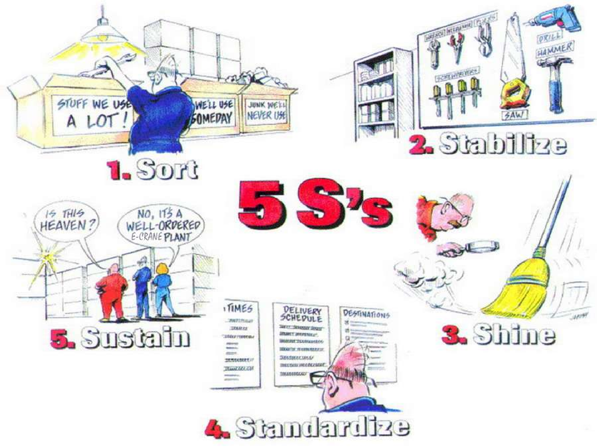

Slide 18

CONCLUSION
The 5-S practice is a well-recognised methodology used by the Japanese for improving the work environment.
It was found to be key to quality and productivity.
The 5-S practice helps everyone in the organisation to live a better life.

Slide 19
THANK YOU


