Slide 1
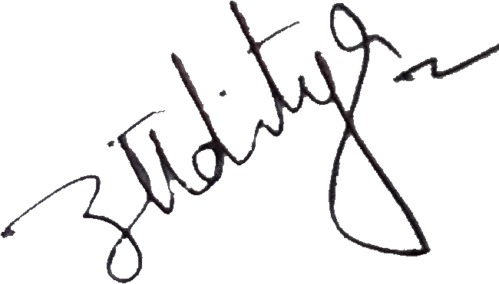
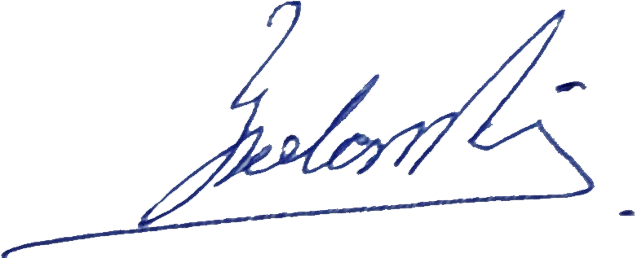
Certificate of Participation
TECHTALKS 4.0
This is to certificate that
Himanshu Madhoriya
has participate in the Webinar on
Decision Making in Fuzzy Environment
Presented by Prof. Ioan Dzitac
On 11th July 2020
Organised By NJR i3 LABS, Techno India NJR Institute of Technology
Aaditya Maheshwari
Principal Investigator
NJR i3 LABS
Yogendra Singh Solanki
IEEE SB Counselor
Techno India NJR

